Slide 1


Non-parametric test
Watshara Shoombuatong

Slide 2
Nonparametric test
Mann Whitney U Test (Wilcoxon Rank Sum Test)
Wilcoxon Signed Rank Test.
The Kruskal-Wallis Test

Slide 3
Non-parametric test
Parametric tests are generally more powerful and can test a wider range of alternative hypotheses.
It is worth repeating that if data are approximately normally distributed then parametric tests (as in the modules on hypothesis testing) are more appropriate.
However, there are situations in which assumptions for a parametric test are violated and a nonparametric test is more appropriate.

Slide 4
There are some situations when it is clear that the outcome does not follow a normal distribution. These include situations:
when the outcome is an ordinal variable or a rank,
when there are definite outliers or
when the outcome has clear limits of detection.

Slide 5
The basic distinction for paramteric versus non-parametric is:
If your measurement scale is nominal or ordinal/ outliers/ very small sample size that you can’t remove then you use non-parametric statistics
If you are using interval or ratio scales you use parametric statistics.

Slide 6
Parametric analyses | Sample size guidelines
1-sample t test | Greater than 20
2-sample t test | Each group should be greater than 15
One-Way ANOVA | If you have 2-9 groups, each group should be greater than 15.
 | If you have 10-12 groups, each group should be greater than 20.

Slide 7
Tests with Two Independent Samples
Mann Whitney U Test (Wilcoxon Rank Sum Test)
A popular nonparametric test to compare outcomes between two independent groups is the Mann Whitney U test.
The Mann Whitney U test, sometimes called the Mann Whitney Wilcoxon Test or the Wilcoxon Rank Sum Test, is used to test whether two samples are likely to derive from the same population (i.e., that the two populations have the same shape).

Slide 8

Mann Whitney U test: Example
Consider a Phase II clinical trial designed to investigate the effectiveness of a new drug to reduce symptoms of asthma in children. A total of n=10 participants are randomized to receive either the new drug or a placebo. Participants are asked to record the number of episodes of shortness of breath over a 1 week period following receipt of the assigned treatment. The data are shown below.

Slide 9
Mann Whitney U test: Example I
Is there a difference in the number of episodes of shortness of breath over a 1 week period in participants receiving the new drug as compared to those receiving the placebo? By inspection, it appears that participants receiving the placebo have more episodes of shortness of breath, but is this statistically significant?

Slide 10

Mann Whitney U test: Example II
A new approach to prenatal care is proposed for pregnant women living in a rural community. The new program involves in-home visits during the course of pregnancy in addition to the usual or regularly scheduled visits. A pilot randomized trial with 15 pregnant women is designed to evaluate whether women who participate in the program deliver healthier babies than women receiving usual care. The outcome is the APGAR score measured 5 minutes after birth. Recall that APGAR scores range from 0 to 10 with scores of 7 or higher considered normal (healthy), 4-6 low and 0-3 critically low. The data are shown below.

Slide 11
Wilcoxon Signed Rank Test: Example I
Consider a clinical investigation to assess the effectiveness of a new drug designed to reduce repetitive behaviors in children affected with autism. If the drug is effective, children will exhibit fewer repetitive behaviors on treatment as compared to when they are untreated. A total of 8 children with autism enroll in the study. Each child is observed by the study psychologist for a period of 3 hours both before treatment and then again after taking the new drug for 1 week. The time that each child is engaged in repetitive behavior during each 3 hour observation period is measured. Repetitive behavior is scored on a scale of 0 to 100 and scores represent the percent of the observation time in which the child is engaged in repetitive behavior. For example, a score of 0 indicates that during the entire observation period the child did not engage in repetitive behavior while a score of 100 indicates that the child was constantly engaged in repetitive behavior. The data are shown below.

Slide 12
Wilcoxon Signed Rank Test: Example I
Child | Before Treatment | After 1 Week of Treatment
1 | 85 | 75
2 | 70 | 50
3 | 40 | 50
4 | 65 | 40
5 | 80 | 20
6 | 75 | 65
7 | 55 | 40
8 | 20 | 25

Slide 13
Wilcoxon Signed Rank Test: Example II
Nine experts rated two brands of Colombian coffee in a taste-testing experiment. A rating on a 7-point scale is given for each of four characteristics: taste, aroma, richness, and acidity. The following table (data stored in the file ) displays the summated ratings—accumulated over all four characteristics. At the 0.05 level of significance, is there evidence of a difference in the median summated rating between brand A and brand B?

Slide 14
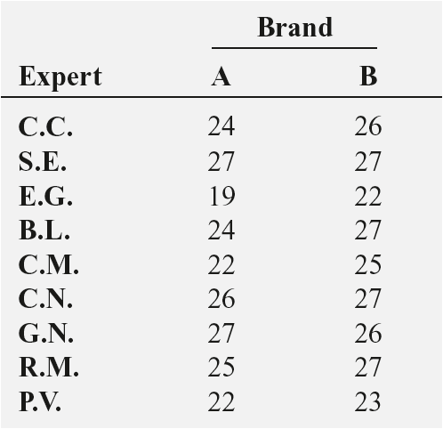
Wilcoxon Signed Rank Test: Example II

Slide 15
Tests with More than Two Independent Samples
In the modules on hypothesis testing we presented techniques for testing the equality of means in more than two independent samples using analysis of variance (ANOVA).
An underlying assumption for appropriate use of ANOVA was that the continuous outcome was approximately normally distributed or that the samples were sufficiently large (usually n_{j}> 30, where j=1, 2, ..., k and k denotes the number of independent comparison groups).
An additional assumption for appropriate use of ANOVA is equality of variances in the k comparison groups. ANOVA is generally robust when the sample sizes are small but equal. When the outcome is not normally distributed and the samples are small, a nonparametric test is appropriate.

Slide 16
The Kruskal-Wallis Test
A popular nonparametric test to compare outcomes among more than two independent groups is the Kruskal Wallis test.
The Kruskal Wallis test is used to compare medians among k comparison groups (k > 2) and is sometimes described as an ANOVA with the data replaced by their ranks.
The null and research hypotheses for the Kruskal Wallis nonparametric test are stated as follows:
H₀: The k population medians are equal versus
H₁: The k population medians are not all equal

Slide 17
The Kruskal-Wallis Test: Example I
A clinical study is designed to assess differences in albumin levels in adults following diets with different amounts of protein. Low protein diets are often prescribed for patients with kidney failure. Albumin is the most abundant protein in blood, and its concentration in the serum is measured in grams per deciliter (g/dL). Clinically, serum albumin concentrations are also used to assess whether patients get sufficient protein in their diets. Three diets are compared, ranging from 5% to 15% protein, and the 15% protein diet represents a typical American diet. The albumin levels of participants following each diet are shown below.

Slide 18
The Kruskal-Wallis Test: Example I
5% Protein | 10% Protein | 15% Protein
3.1 | 3.8 | 4.0
2.6 | 4.1 | 5.5
2.9 | 2.9 | 5.0
 | 3.4 | 4.8
 | 4.2
Is there is a difference in serum albumin levels among subjects on the three different diets.

Slide 19
The Kruskal-Wallis Test: Example I
Step 1. Set up hypotheses and determine level of significance.
H₀: There is not a difference in serum albumin levels among subjects on the three different diets.
H₁: There is a difference in serum albumin levels among subjects on the three different diets.

Slide 20
The Kruskal-Wallis Test: Example I
Step 2: Set the critical region
The appropriate critical value can be found in the table. To determine the appropriate critical value we need sample sizes (n₁=3, n₂=5, n₃=4) and our two-sided level of significance (α=0.05). For this example, the critical value of W is 6 and the decision rule is
Reject H₀ if H > 5.656,
Accept H₀ if H < 5.656

Slide 21
Step 3: Compute the test statistic.
 |  |  | Total Sample (Ordered Smallest to Largest) |  |  | Ranks
5% Protein | 10% Protein | 15% Protein | 5% Protein | 10% Protein | 15% Protein | 5% Protein | 10% Protein | 15% Protein
3.1 | 3.8 | 4.0 | 2.6 |  |  | 1
2.6 | 4.1 | 5.5 | 2.9 | 2.9 |  | 2.5 | 2.5
2.9 | 2.9 | 5.0 | 3.1 |  |  | 4
 | 3.4 | 4.8 |  | 3.4 |  |  | 5
 | 4.2 |  |  | 3.8 |  |  | 6
 |  |  |  |  | 4.0 |  |  | 7
 |  |  |  | 4.1 |  |  | 8
 |  |  |  | 4.2 |  |  | 9
 |  |  |  |  | 4.8 |  |  | 10
 |  |  |  |  | 5.0 |  |  | 11
 |  |  |  |  | 5.5 |  |  | 12

Slide 22
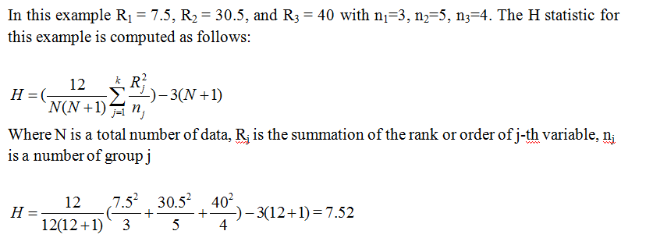
The Kruskal-Wallis Test: Example I

Slide 23
The Kruskal-Wallis Test: Example I
Step 4: Make a decision.
To determine the appropriate critical value we need sample sizes (n₁=3, n₂=5 and n₃=4) and our level of significance (α=0.05). For this example the critical value is 5.656, thus we reject H₀ because 7.52 > 5.656, and we conclude that there is a difference in median albumin levels among the three different diets.

Slide 24
The Kruskal-Wallis Test: Example I
Step 5: Conclusion.
In conclusion, there is insufficient evident at the 0.05 significance level to conclude that there is not a difference in median albumin levels among the three different diets.

Slide 25
The Kruskal-Wallis Test: Example I
After we know that there a difference among the three different groups, There are the five steps to check which pair of group is different:
Step 1: Compute the standard error (S.E.)
Step 2: Compute the minimum significant difference (MDE)
Step 3: Consider between MSD and the different between group

Slide 26

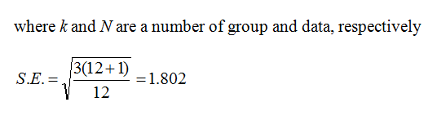
The Kruskal-Wallis Test: Example I
Step 1: Compute the standard error (S.E.)

Slide 27
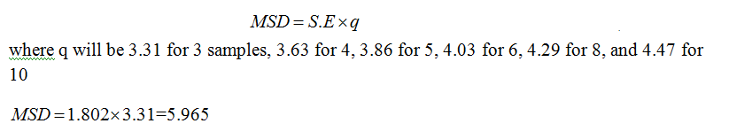
The Kruskal-Wallis Test: Example I
Step 2: Compute the minimum significant difference (MDE)

Slide 28
The Kruskal-Wallis Test: Example I
Step 3: Consider between MSD and the different between group
In this example R₁ = 7.5, R₂ = 30.5, and R₃ = 40 with n₁=3, n₂=5, n₃=4. Thus, the average of G1, G2, and G3 are 7.5/3 = 2.5, 30/5 = 6.1, and 40/10 = 10, respectively.
The different among three groups:
|G1 vs G2|=|2.5-6.1| = 3.6 < 5.965
|G1 vs G3|=|2.5-10| = 7.5 > 5.965
|G2 vs G3|=|6.1-10| = 3.9 < 5.965

Slide 29
Step 3: Consider between MSD and the different between group
The only value to exceed the MSD value of 5.965 is that of the G1 / G3 pair (7.5). Now we can say that the sample of 15% Protein gave statistically (significantly) higher albumin levels than the sample of 5% Protein.
 | G1 (2.5) | G2 (6.1) | G3 (10)
G1 (2.5) |  | 3.6 | 7.5
G2 (6.1) |  |  | 3.9
G3 (10)

Slide 30
The Kruskal-Wallis Test: Example II
Sample question: A shoe company wants to know if three groups of workers have different salaries: Women: 23K, 41K, 54K, 66K, 78K. Men: 45K, 55K, 60K, 70K, 72K Minorities: 18K, 30K, 34K, 40K, 44K.

